Slide 1
Putting it all together: Assessing Liver Enzyme and Liver Function Tests
Complete this chart
 | ALT/AST | GGT | ALP | Total Bilirubin | Direct Bilirubin | Indirect
 | ASAP | Drug induced | Bone and billary |  | Conjugated | Bilirubin
 |  |  |  |  |  | Not conjug
Hepatocellular | increase b/c damage | Increase b/c damage | none b/c only bone and bilary | increase | decrease b/c it cannot make enough conjugated | increase b/c cannot conjugate
Disease
Cholestatic Diseases | Normal | Increase b/c a lot of GGT in billary duct | High b/c billary | Increase b/c build up | High b/c buildup | Normal b/c normal liver
Hemolytic disease | None b/c no liver | none b/c no liver | None | increase | increase | increase
Bone Disease | none | none | Increase | none | None | none
Note: Albumin is decreased in liver disease. The PT is prolonged in liver disease.

Slide 2
Drug Induced Hepatotoxicity
Terms
Cholestasis: Any condition in which the flow from liver to bile is slowed or blocked. Drugs that bind to transport proteins at the calicular membrane and disable bile salt export. Note: little cell injury occurs
Adducts: Drugs covalently bound to enzymes. Drugs by themselves are relatively small molecules which won’t evoke and immune response. However, adducts (drug + enzyme) are large enough to serve as immune targets and induce T-cell response. If the Adducts are in the hepatocytes (liver), cytokine may cause inflammation and eventually apoptosis, destroying hepatocytes.

Slide 3
Cytotoxic Hepatoxic Hepatic Injury (acute hepatic toxicity)
pruritus, coagulopathy
Malabsorption of fat soluble vitamins (ADEK)
Hypoglycemia and Hyperglycemia ascites
Spontaneous bacterial peritonitis
Encephalopathy with increased intracranial pressure
Variceal hemorrhage
Hepatorenal syndrome
Electrolyte abnormalities

Slide 4
Clinical Consequences
Labs:
- Hepatoxic drug reactions evoke injury to hepatocytes similar to viral hepatitis, characterized by rapid onset of malaise and jaundice elevated aminotransferase levels (AST/ALT)
Cholestatic Syndromes causes elevated alkaline phosphatase and bilirubin levels
Hepatic Veno-occlusive disease
- Prophylaxis with Ursodiol
Idiosyncratic reactions
The majority if idiosyncratic drug reactions involve damage to hepatocytes throughout the hepatic lobule with various degrees of necrosis and apoptosis.
Allergic Reactions
Examples
Sulfa: rash, fever, eosinophilia
Phenytoin: rash, fever, severe hepatocyte injury, (termed reactive metabolite syndrome)
Halothane (inhalational general anesthetic): slow immuno allergic reaction for months
How to solve: d/c drug
Bile-Duct Injury
Cholestasis predominates, causing jaundice and pruritus (itching)
Notes:
The normal range of values for AST (SGOT) is from 5 to 40 units per liter of serum (the liquid part of the blood).
The normal range of values for ALT (SGPT) is from 7 to 56 units per liter of serum.

Slide 5
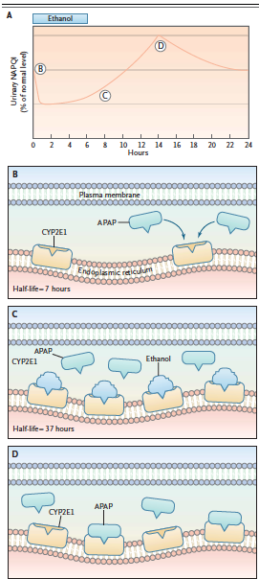
The APAP + Ethanol Story
Chapter A. Graph shows that NAPQI is hepatotoxic
Chapter B. CYP2E1 metabolizes APAP to NAPQI. NAPQI is starting to make the liver toxic.
Chapter C. Ethanol joins (person starts drinking) and makes the CYP2E1 overwhelmed because he has to metabolize both APAP and ethanol. CYP2E1 starts to increase his half-life so he can work longer to metabolize everything.
Chapter D. The person stops drinking. Ethanol is removed, leaving APAP and a lot CYP2E1. CYP2E1 starts metabolizing APAP to a lot of NAPQI. NAPQI starts overwhelming the liver, jacking it up.
Chapter E. The liver freaks out and starts producing large amounts of aminotransferase (AST/ALT) saying that the liver is toxic. Normal values of AST/ALT is < 50 IU/Liter. After APAP toxicity, the AST/ALT is > 3500 IU/Liter.
Chapter F. The pharmacist looks at the lab pts drug Hx (has APAP) and AST/ALT lab values and says, “This is APAP toxicity. We need N-Acetylcysteine given for 72 hours to replete the glutathione and prevent injury if begun within 24 hours after ingestion.”

Slide 6
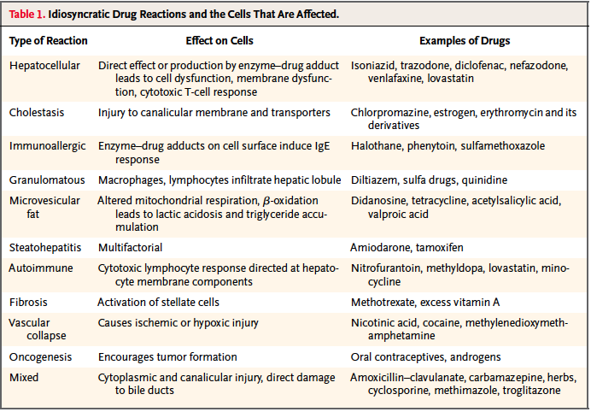
Know Isoniazid, Diclofenac

